Slide 1
© 2016 Blackboard Inc.
All rights reserved.

Slide 2
Objectives
Explain how you can use Blackboard Learn to accomplish familiar teaching tasks.
Identify characteristics for success in the online environment.
Navigate the My Institution tab, the global navigation menu, and the course environment.
Create your course menu and home page.
Share ideas for welcoming your students.

Slide 3
Contact Info
Add here or delete slide
Add here

Slide 4
Blackboard Learn
Blackboard Learn is an application for online teaching, learning,
community building, and knowledge sharing.

Slide 5
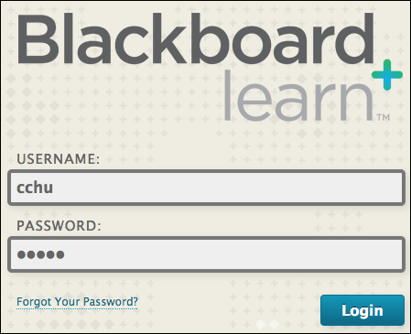
LOGGING IN

Slide 6
PAGE HEADER

Slide 7
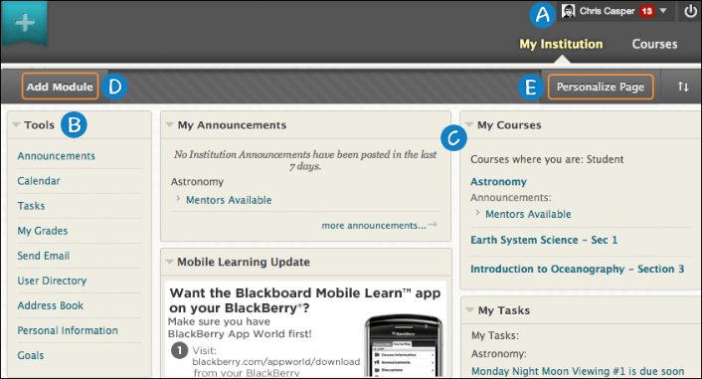
MY INSTITUTION TAB
Notes:
The global navigation menu is available everywhere in Blackboard Learn. Click the arrow next to your name at the top of the screen.
Tools: View announcements and grades for all courses a user is enrolled in. Send email to course members. View course calendar dates and tasks added by instructors. Add private personal calendar events and tasks. Access and edit personal information.
Modules: Use links to view information and navigate to courses. My Institution tab modules collect information from all the courses you are enrolled in or teaching, giving you a total picture of news and activity for your courses. Your school determines which modules appear. You can collapse individual windows and change the position of modules. To move a module, point to the title bar to access the four arrows, press and drag the module into its new location, and release.
Add Module: Click to view the list of available modules, such as dictionary, report card, and notes. Descriptions are provided in the list so you can choose the most significant. Your school determines if users are allowed to add modules.
Personalize Page: Change the color scheme of the page. Your school determines if users are allowed to personalize the page.

Slide 8
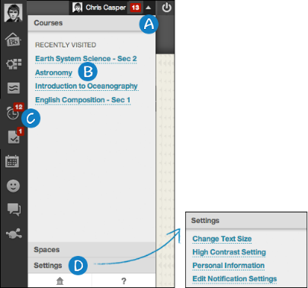
GLOBAL NAVIGATION
Notes:
Click the arrow next to your name to access the global navigation menu.
On the right, users can access their courses, organizations, school links, and personal settings. If your school has enabled spaces, users can also access any spaces they follow.
From one location, the My Blackboard menu conveniently allows users to view and take action on their critical academic information. It aggregates user information from across the Blackboard Learn system. Students can open tools to view course activity, the calendar, grades, and more.
Click the Settings link to update personal information, edit notification settings, change a password, and add an avatar.
NOTE: If your school enables the profiles feature, then the images students upload in their profiles will supersede the avatar images. Blackboard profiles are not available if your school has not enabled Blackboard cloud features.

Slide 9
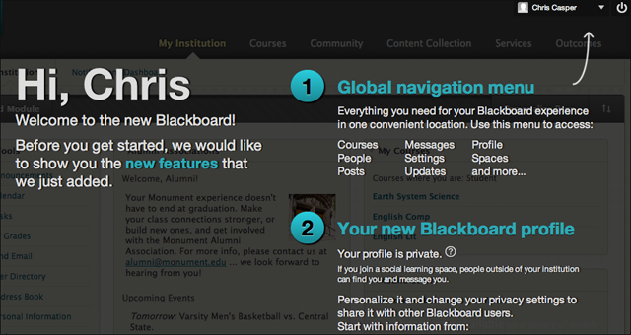
MY BLACKBOARD

Slide 10
TRY IT
Use your Practice Course to explore the page header and My Institution tab.

Slide 11
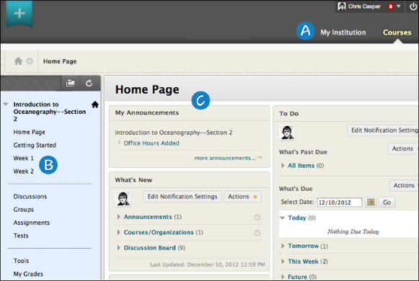
THE COURSE ENVIRONMENT
Notes:
Page header: Identical to the page header when logging in, including the My Institution and Courses tabs. Reminder: Your school can rename tabs.
Course menu: The access point for all course content added by an instructor.
Content frame: Displays the selected tool or content area. By default, when users enter a course, the Home Page appears. The first page they see is chosen by the instructor and is called the course entry point.

Slide 12
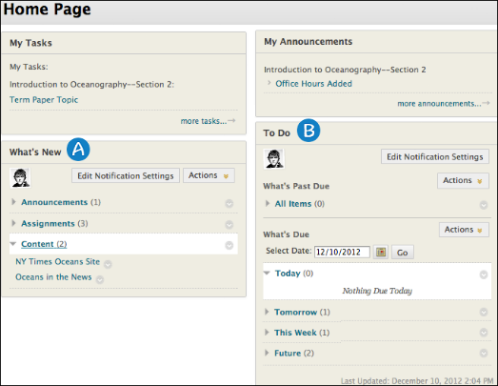
THE HOME PAGE
Notes:
What’s New: Contains links to new content, such as announcements, assignments, tests, surveys, newly graded items, mashups, and unread discussion board messages.
To Do: Divided into What’s Past Due and What’s Due. Students can use this information as the launching point for their daily course work.

Slide 13
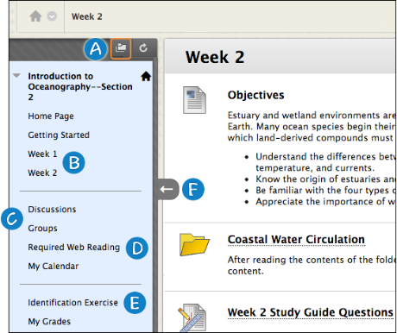
THE COURSE MENU
Notes:
Display Course Menu in a New Window: When you open the course menu in a new window, you can move it anywhere on the page. When used in combination with hiding the course menu, you have more screen space to view content.
Content areas: Top-level containers that organize and store course content, such as lecture notes, assignments, and tests. In the preceding image, the Week 1 and Week 2 content areas contain items that students need in one-week periods. The Week 2 content area is open in the content frame. The instructor used a folder to further organize content.
Individual tools: Links to tools students need often, such as the Discussion Board and Groups.
Web links: Direct access to websites used for assignments.
Course links: Direct links to content also available in a content area that you do not want students to miss.
Hide/Show Course Menu: You can expand or collapse the course menu by moving your mouse pointer near the border and clicking the arrow.

Slide 14
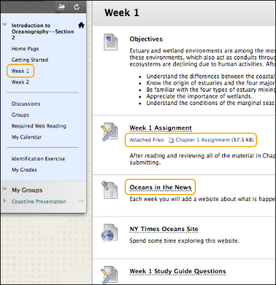
CONTENT AREAS
Notes:
To navigate content areas:
On the course menu, click the name of the content area. The content appears in the content frame.
In the content frame, click a link to access content, such as a file link or a discussion board forum link.

Slide 15
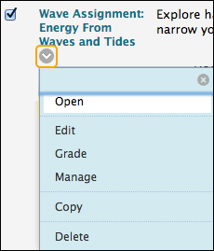
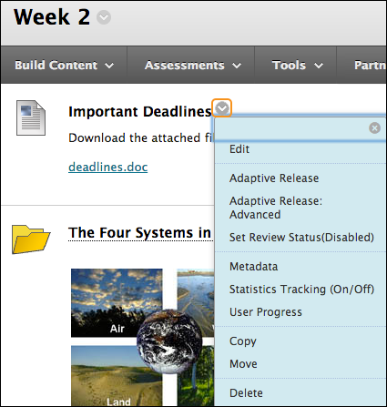
CONTEXTUAL MENUS

Slide 16
EDIT MODE
Notes:
Click Edit Mode to change from ON to OFF. When Edit Mode is ON, all instructor functions are available. When Edit Mode is OFF, the instructor functions are hidden.
For example, when Edit Mode is ON, the course menu’s Add Menu Item function is available, which is shown as a plus sign. Use this function to add links to the course menu. Students do not see this function.

Slide 17
STUDENT PREVIEW

Slide 18
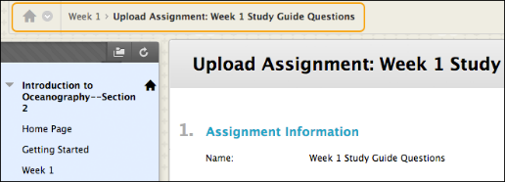
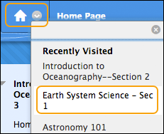
NAVIGATION

Slide 19
PAGE HELP

Slide 20
TRY IT
Use your Practice Course to explore the course menu and tools link.

Slide 21
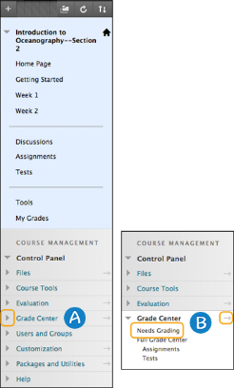
CONTROL PANEL
Notes:
Expand each of the sections on the Control Panel by clicking the arrow next to a title. A menu appears directly below each section title.
Select an option in the menu. Alternately, expand a section into the content frame by clicking the right pointing arrow.

Slide 22
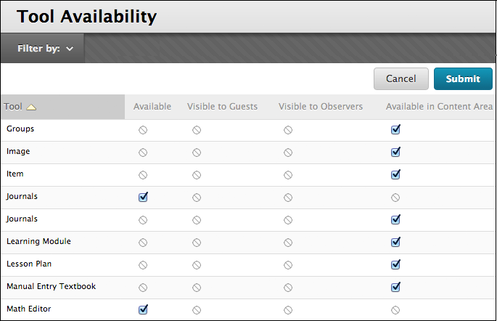
TOOL AVAILABILITY

Slide 23
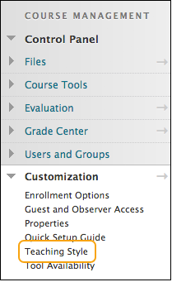
COURSE STYLE

Slide 24
TRY IT
Use your Practice Course to make customizations.

Slide 25
PLAN COURSE MENU LINKS
A good initial strategy is to keep the course menu
as simple as possible.

Slide 26
TRY IT
Use your Practice Course to experiment with the
course menu.

Slide 27
BEST PRACTICE
Discuss ways to welcome your students.

Slide 28
FREQUENTLY ASKED QUESTIONS
Effective ways to organize the course menu?
What type of image format is best for banners?

Slide 29
WRAP UP
To learn more, visit help.blackboard.com.

